Slide 1

Impacts of pandemic relief benefits on income measures
Xuelin Zhang
Statistics Canada
May 10, 2023

Slide 2
Plan of presentation
Pandemic relief benefit data, an overview
Pandemic relief benefits, classification of income and income indicators
Assessing the impacts of the pandemic relief benefits: the basic idea
Main methods, examples and illustrations
New and existing data sources for municipalities and communities
Questions and discussion

Slide 3
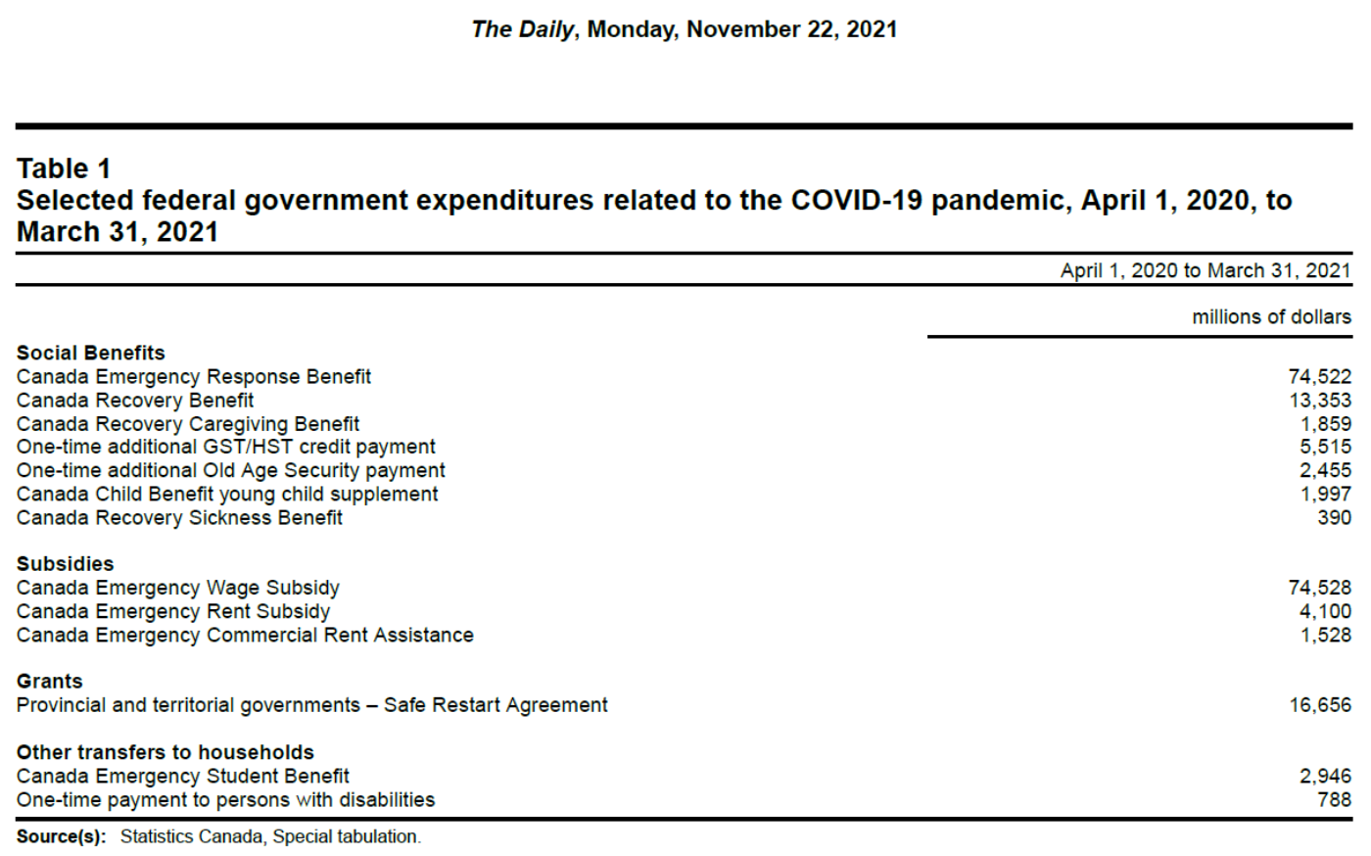
Total government spending exceeded $200bn

Slide 4
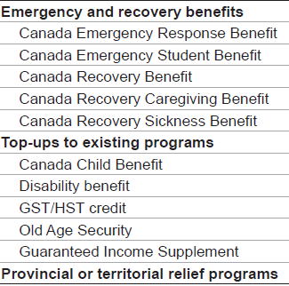
This presentation focuses on the impacts of the pandemic relief benefits paid to individuals and families
Notes:
Top-ups to existing programs AKA Enhancements to existing federal programs

Slide 5
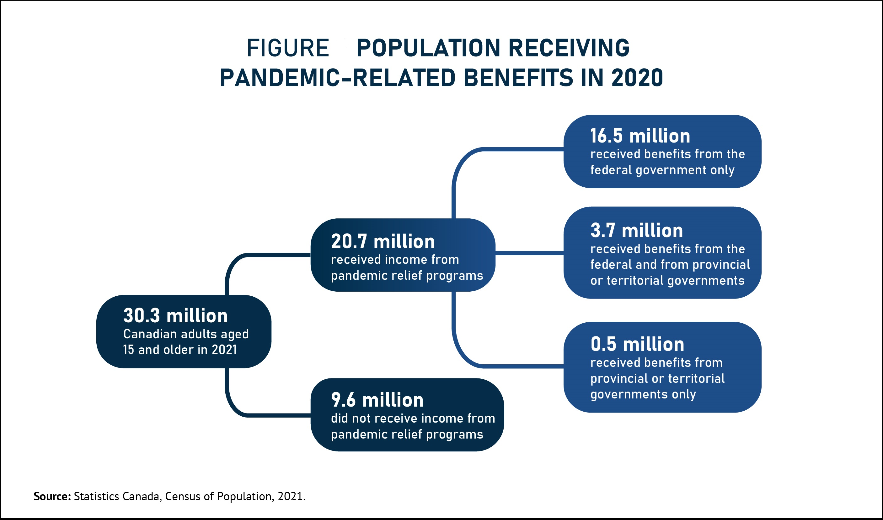
More than two-third (68.4%) Canadian adults received money from pandemic relief benefits
Statistics Canada (2022): “The contribution of pandemic relief benefits to
the incomes of Canadians in 2020”.

Slide 6
How much did Canadians receive the pandemic relief benefits?
COVID-related benefits: % receiving and median amount received, Canada, 2020
 | (%) | (2020 $)
Emergency and recovery benefits
Canada Emergency Response Benefit | 25.1 | 8,000
Canada Emergency Student Benefit | 2.4 | 5,000
Canada Recovery Benefit | 3.8 | 5,000
Canada Recovery Caregiving Benefit | 0.7 | 3,000
Canada Recovery Sickness Benefit | 0.8 | 1,000
Top-ups to existing programs
Canada Child Benefit | 12.2 | 600
Disability benefit | 4.6 | 600
GST/HST credit | 36.1 | 424
Old Age Security | 18.9 | 300
Guaranteed Income Supplement | 6.4 | 200
Provincial or territorial relief programs | 13.8 | 276
Statistics Canada (2022): “The contribution of pandemic relief benefits to
the incomes of Canadians in 2020”.

Slide 7
Total (before-tax) income =
Market income =
Employment income =
Wage, salary, commission
+ Self-employment income
+ Investment income
+ Private pension income
+ Other market income
+ Government transfers =
OAS/GIS
+ C/QPP
+ EI benefits
+ CCB
+ Other government transfers
- Income taxes =
Federal income tax
+ Provincial/territorial income tax
= After-tax income
Where do the pandemic relief benefits fit in the Canadian classification of income measures

Slide 8
Where do pandemic relief benefits fit in the income classification
They are part of total (before-tax) income
They affect after-tax income via
both total income and income taxes
    After-tax income =
      Total income – Income taxes
      (Income taxes = Fed. + Prov./terr.)
Pandemic benefits =
Taxable: ERBs +
Non-taxable top-ups

Slide 9

-- Mean or median after-tax income
-- Low-income rate
-- Poverty rate
-- Inequality
-- Core housing need
Aggregate measures to be used in this presentation

Slide 10
Assessing the impacts of the pandemic benefits: the basic idea
Bob received ERB payments in 2020
His total income in 2020 was Y_{Bob, 2020} (actual/factual income)
What if he did not receive any ERB? What would be his total income? The total income he would receive, W_{Bob,2020} is called the counterfactual income
Then the impact of ERBs would be: ∆_{Bob} = Y_{Bob, 2020} – W_{Bob,2020}
We need to find a replacement for W_{Bob,2020} to assess the impact of ERB on Bob’s total income

Slide 11

Not an easy task because of the “what if” question:
What if I had never let you go?
Would you be the man I used to know?
If we could only turn back time…
But I guess we’ll never know!
-- The “Titanic” theme song

Slide 12

From the artist’s frame of thinking to random experiment
Random experiment offers the the best solution but is not always feasible!

Slide 13

Non-experimental methods
Observational/decomposition
Accounting the effect
Simulation
Econometrician
  Difference-in-difference
  Statistical matching
  ……

Slide 14
Observational/decomposition analysis
Comparing things over time for a population or sub-population
  Y₂₀₂₀ versus Y₂₀₁₉
  Y₂₀₂₀ versus Y₂₀₁₅
  ∆(Y₂₀₂₀ , Y₂₀₁₅) versus ∆(Y₂₀₁₅, Y₂₀₁₀)
Many factors were behind an observed change. Examine the change in each factor and assessing the its contribution to the overall change
  change in after-tax income = change in market income +
  change in transfer income +
  change in income taxes

Slide 15
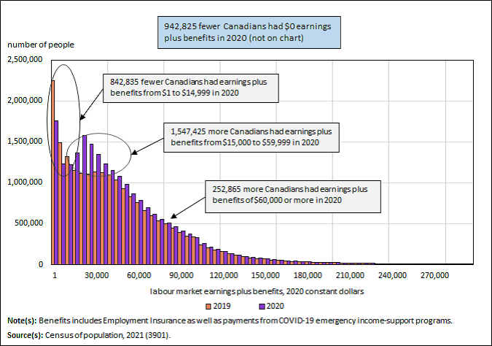
Observational analysis
Emergency and recovery benefits help offset losses among low-wage earners in 2020
Statistics Canada, “The Daily, July 13, 2022”.

Slide 16
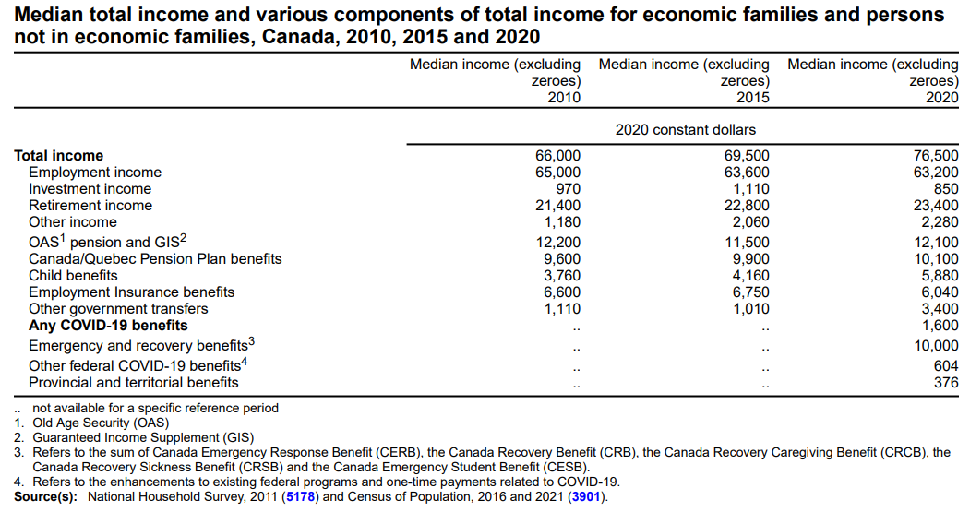
Observational analysis
Median family total income grew twice faster between 2015 and 2020 (10.1%) than in the previous five-year period (5.3%)
Child benefits (42.3% versus 10.6%)
Other government transfers (236.7% versus -9.1%)
Statistics Canada, “The Daily, July 13, 2022”.

Slide 17
Observational analysis
Share of child benefits rose from 1.5% to 1.8% (+20.0%)
Share of other government transfers rose from 2.1% to 7.5% (+257.1%)

Slide 18
Decomposition analysis
Aggregate after-tax income rose $152 billion between 2015 and 2020.
More than half of the increase (59.0%) came from other government transfers (mainly ERB and top-ups)

Slide 19
An Accountant’s solution:
Take the benefits out from the formula
Assume no behavioural changes: Bob would do nothing in the absence of the pandemic relief benefits
W_{Bob,2020} = Y_{Bob, 2020} – Benefits received.
Recalculate the income and wellbeing indicators

Slide 20
To what extent did the pandemic relief benefits help boost Canadians’ after-tax income?
 | Median with pandemic benefits | Median without pandemic benefits | Share of benefits in median after-tax income
All benefit recipients | 32,800 | 28,400 | 13.4
Women+ | 32,000 | 27,400 | 14.4
Men+ | 33,600 | 29,800 | 11.3
15 to 19 years old | 14,600 | 8,400 | 42.5
20 to 24 years old | 23,800 | 16,800 | 29.4
25 to 54 years old | 38,800 | 34,400 | 11.3
55 to 64 years old | 31,200 | 25,800 | 17.3
65 and older | 30,000 | 28,200 | 6.0
Bottom decile | 8,000 | 3,360 | 58.0
Second decile | 15,200 | 10,100 | 33.6
Third decile | 19,800 | 16,000 | 19.2
Fourth decile | 24,800 | 22,200 | 10.5
Fifth decile | 31,600 | 28,400 | 10.1
Sixth decile | 38,800 | 36,400 | 6.2
Seventh decile | 46,000 | 44,400 | 3.5
Eighth decile | 55,600 | 54,000 | 2.9
Ninth decile | 69,000 | 67,500 | 2.2
Top decile | 90,000 | 88,000 | 2.2
Accountant’s solution
Statistics Canada (2022): “The contribution of pandemic relief benefits to
the incomes of Canadians in 2020”.

Slide 21
To what extent did the pandemic relief benefits help reduce the low-income rate?
Taking the benefits out and recalculate both household income and the low-income threshold
Accountant’s solution

Slide 22
To what extent did the pandemic relief benefit help reduce inequality in household after-tax income ?
Accountant’s solution

Slide 23
Effect of pandemic relief benefit on core housing need:
Accountant’s solution

Slide 24

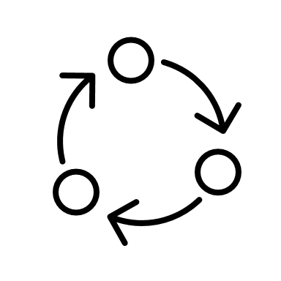
Simulation analysis
Social Policy Simulation Database and Model (SPSDM)
Database
SPSDM Simulator
Simulated data
Parameters

Slide 25
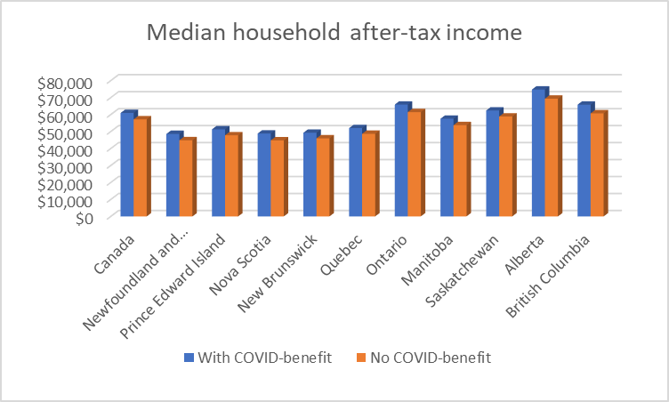
Social Policy Simulation Database and Model (SPSDM)
Microsimulation: take the benefits away and let the computer be the accountant

Slide 26
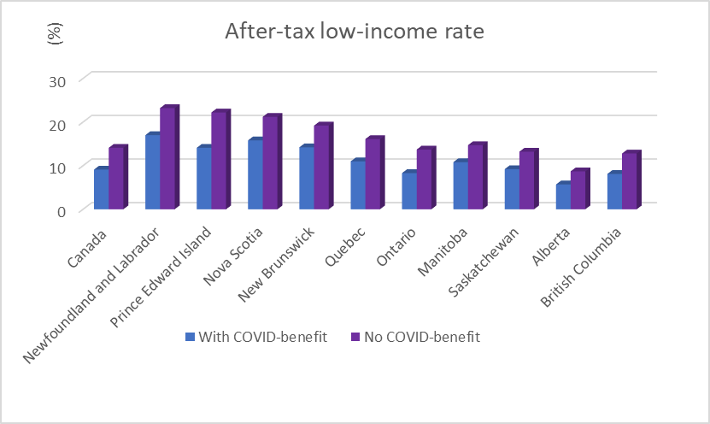
Social Policy Simulation Database and Model (SPSDM)
Simulation analysis

Slide 27
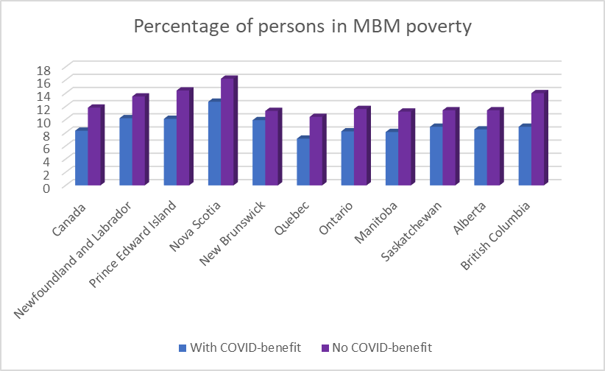
Social Policy Simulation Database and Model (SPSDM)
Simulation analysis

Slide 28
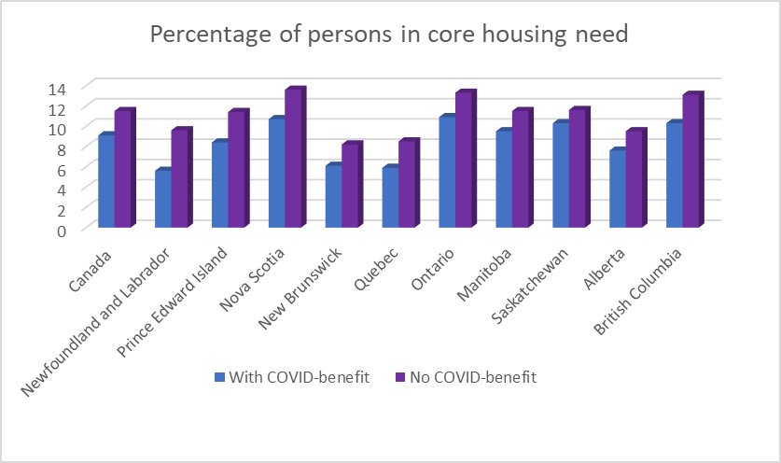
Social Policy Simulation Database and Model (SPSDM)
Simulation analysis

Slide 29
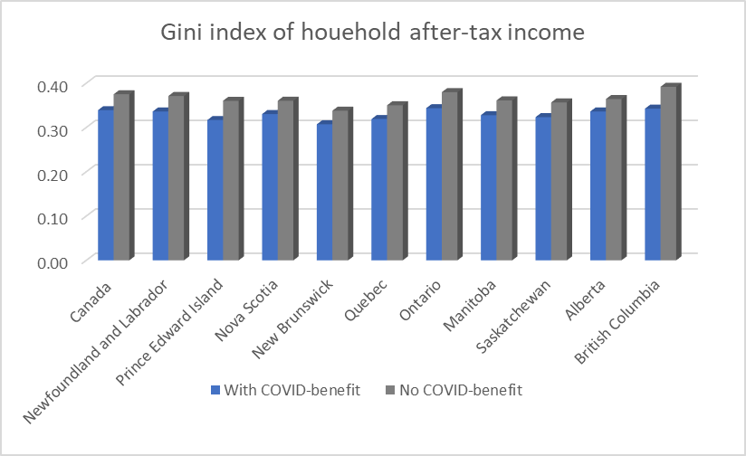
Social Policy Simulation Database and Model (SPSDM)
Simulation analysis

Slide 30
Simple accounting and SPSDM comparison
Similar results under the two methods
SPSDM is more flexible
  Sample size can be expanded
  It allows one to simulate a variety of scenarios at the same time (change pandemic benefits as well as other policy parameters simultaneously)
  MBM poverty can be simulated

Slide 31
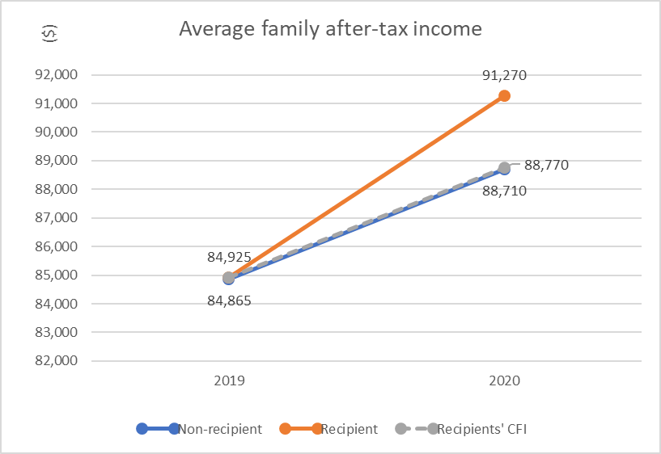
Difference-in-difference estimate: an illustration
Families who did not receive pandemic benefits saw their after-tax income grow from $84,865 in 2019 to $88,710 (+4.5%) in 2020
Families who received pandemic benefits saw after-tax income grow from $84,925 in 2019 to $91,270 in 2020
  If their after-tax income had grown at the same rate as families that did not receive the benefit (4.5%), they would have received $88,770 (the counterfactual income -- CFI)
  Thus, the pandemic relief benefits accounted for $2,500 of the $91,270 total income they received
For families who received pandemic-relief benefits, as much as 2.7% (=$2,500/$91,270) of their after-tax income can be accounted by these benefits
Fine print
  Cautionary words
  Key assumptions
  No control variables have been taken into consideration here
* Longitudinal Administrative Databank, family after-tax income between $80,000 and $90,000 in 2019.
Notes:
Key assumptions: (1) treatment status is independent from pre-treatment income or other variables; (2) income grew at the same rate for both groups of families

Slide 32
Difference-in-difference analysis: an illustration
Families in New Brunswick, Manitoba and BC benefited more from the pandemic-relief programs.
Families in Newfoundland and Labrador and PEI tended to benefit less

Slide 33
Econometrician: propensity score matching
Remember Bob, the recipient of ERB payments whose counterfactual income W_{Bob,2020} was not observable? We said that the solution was to find an approximate to replace W_{Bob,2020}
PS matching means to find a person(s), say Tom, who is akin to Bob, except that he did not receive ERB and his actual income was Y_{Tom,2020} can be used to place W_{Bob,2020}
  ∆_{Bob} = Y_{Bob, 2020} – Y_{Tom,2020}

Slide 34
Econometrician: statistical matching
Identify all variables that affect the chance to receive the pandemic benefits and the outcome (poverty/low income, that cannot affect the chance to receive the benefits).
Estimate the chance for each person to receive the benefit and use the result to find one or more of the Toms who best assembly the Bob and were also eligible but did not receive the benefit
Repeat the above for each recipient (Bobs)
Obtain the difference in the average of the recipients and the average of the matched non-recipients
Fine print – assumption is made that we are able to get the “all variables”

Slide 35
Effect of ERBs on wellbeing indicators for persons who received ERBs: an illustration

Slide 36
Recent and soon-to-be available datasets
  Census: one of the best source for statistics at municipal and local levels
    Census Profile, 2021 Census of Population https://www12.statcan.gc.ca/census-recensement/2021/dp-pd/prof/index.cfm
  T1FF 2021 (preliminary release, March 14, 2023)
    Income and Financial Data of Individuals, Preliminary T1 Family File https://www150.statcan.gc.ca/n1/en/surveys/4106?sourcecode=4106&count=50
    Final data coming end of June
  Canadian Income Survey (CIS) 2021 just became available (May 1, 2023)
    The Daily — Canadian Income Survey, 2021 (statcan.gc.ca) https://www150.statcan.gc.ca/n1/daily-quotidien/230502/dq230502a-eng.htm
  Emergency and recovery benefits Project (Under construction)

Slide 37
Recent and soon-to-be available datasets
Disaggregated Data Action Plan
    https://www.statcan.gc.ca/en/about/reports2/accomplishments2022
  Increased sample sizes to existing surveys
    Labour Force Survey (started)
    Canadian Community Health Survey (done)
    General Social Survey (done)
    Survey on Access to Health Care and Pharmaceuticals During the Pandemic
    Mental Health and Access to Care Survey
  Added contents/sub-modules to existing surveys: Census, LFS, CSS, Survey Series on People and their Communities, Canadian Survey on Business Conditions
  Administrative data linked with existing surveys such as Canadian Census Health and Environment Cohorts

Slide 38
Municipal/local data
Center for Municipal and Local Data Hub
  Who: Federation of Canadian Municipalities and Statistics Canada
  When: October 2020
  What: Municipal Financial and Socioeconomic Data Dashboard (and others), facilitates city profiling, city comparison, multi-city comparison under the following dimensions/indicators:
      Demographic -- age distribution and population growth
      Social living -- crime index and severity
      Cost of living -- CPI and housing price index
      Labour -- labour market participation, employment and unemployment
      Finance – revenue and expense

Slide 39
Open data
The Linkable Open Data Environment
  What: open space/data/tools under the Open Government Licence – Canada
  Where: https://www.statcan.gc.ca/en/lode
  Statistics Canada’s role: harmonization and standardization
  Some available datasets
    The Open Database of Greenhouses
    The Open Database of Educational Facilities
    The Open Database of Healthcare Facilities
    The Open Database of Cultural and Art Facilities
    The Open Database of Recreational and Sport Facilities
    The Open Database of Businesses (under development)
    The Open Database of Infrastructures (under development)

Slide 40
Open data
The Linkable Open Data Environment – open tools and space
  Open space
    Where: github.com/CSBP-CPSE/LODE-ECDO
    What: source codes, scripts, and source files
  Open tools
    OpenTabulate: data retrieval, tabulation and processing
Cautions
  Exploratory nature
  Independent from other Statistics Canada products

Slide 41
Summary
Big spending on pandemic relief programs
Significant impacts on income indicators
Not easy to quantify the impacts due to the lack of counterfactual
Accountable with available data, assuming no behavioural changes
  Decompositions are straightforward
  Simulation analyses can be helpful
  Other methods are highly technical
More data at your service

Slide 42
Questions?
Thank you
xuelin.zhang@statcan.gc.ca
613-853-8991

