Slide 1
Community Data Program Canadian Council on Social Development Leads’ Meeting
September 21, 2018

Slide 2
1. Welcome
Agenda:
Welcome
CDP Strategic Plan 2017-2018
Data Access Update
Training & Building Capacity Update
Website Refresh Project
Administrative Updates
Next AGM

Slide 3
2. CDP Strategic Plan 2017-2022 - update
Achieving a Collaborative Impact on Social Development through evidence-based decision making and action

Slide 4
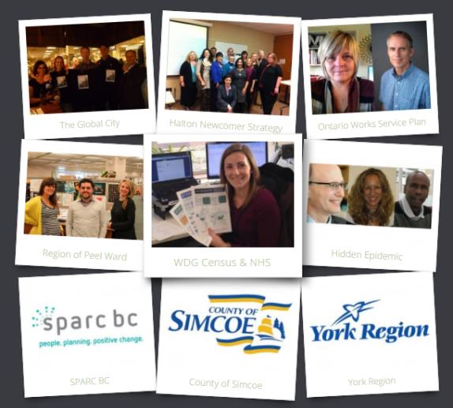
Program Vision
Enabling communities to measure and track community well-being
The vision of the CDP is to enable communities to measure and track community well-being through access to, and the effective use of, community data.

Slide 5
Goals and Program Areas: PA1 Program Leadership
The CDP Seeks to be…
A leader in its field, playing an active role in ongoing debates about data literacy, data ethics, and new sources of information including administrative data, open data, and big data.
Well known across Canada, with strong partnerships in place with communities, governments, and funders at the local, regional and national levels.

Slide 6
PA2 Data Acquisition & Planning
The CDP Seeks to…
continue to maintain and expand Canada’s single largest source of community data designed by and for community data practitioners.
continue to evolve as Canada’s one-stop shop for community data, based on the principle of building a repository that reflects the needs and priorities of CDP members, and is accessible to all CDP users.

Slide 7
PA3 Training & Capacity Building
The CDP Seeks to be…
An effective capacity builder, its actions resulting in positive uptake and improvements among members in their ability to generate, use and present community data.

Slide 8
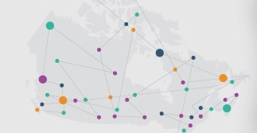
PA4 Communication & Networking
The CDP Seeks to be…
An enabler of a vibrant network to support evidence-based social development.
A producer of influential knowledge products through the CDP and CCSD.
A program that monitors its performance and demonstrates the impact of its work in facilitating the generation of evidence for community development.

Slide 9
PA5 Program Administration
The CDP Seeks to be…
An efficient program administrator, providing backstop support to the achievement of the vision and strategic goals, and aiming for excellence in the deployment of administrative tools and procedures.

Slide 10
3. Data access updates
Update from the Data Purchase and Access Working Group
Update on recent data acquisitions for 2017-18
Update on custom geographies
Update on Census priority setting

Slide 11
Data Purchase and Access Working Group
Identify data needs, improve data access, acquire data, and address related technical concerns
Current members
Meeting notes available at http://communitydata.ca/dpawg
Next meeting October 4th
@ 2:30pm Eastern time.
Calgary | Nova Scotia
Erie-St. Clair | Peel
Halton | Simcoe
Northern Ontario | Kingston Frontenac Lennox and Addington
Toronto | Wellington-Dufferin-Guelph
Montreal | Winnipeg
Hamilton | York
Notes:
Greater meeting frequency this year

Slide 12
Data Purchase and Access Working Group
Discussions highlights
211 data
Income inequality
Equifax data
Taxfiler custom order
Census priorities
Custom geographies
Target Group Profiles
Activity limitations data
Community Poverty Project

Slide 13
Data access – Recent acquisitions
Police Resources in Canada
Postal Code Conversion File
CMHC Comprehensive New Home and Rental Market tables
Labour Force Survey estimates
Canadian Business Counts
Insolvency data
updated Non-Mortgage Consumer Debt data
Schedule B available at communitydata.ca/programresources

Slide 14
Data access – Recent acquisitions
T1FF (taxfiler tables)
Income of Families
Income of Individuals
Income of Seniors
Financial data and Charitable Donations
Coming Soon
Income Inequality, Working Poor
Migration estimates
Schedule B available at communitydata.ca/programresources

Slide 15
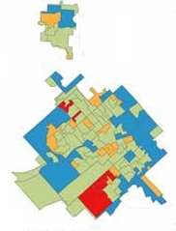
Custom geographies
Geocoding progress
Production system delayed – operational by October 25th (we hope!)
Tables will be produced by community
Review process will begin early October
LEADS WILL BE CONTACTED FOR SIGN-OFF!

Slide 16
Census priority setting
Ensure that high priority tables will be acquired
DPAWG will evaluate items with no download history
By October 4th:
Start order for 2 income tables and 1 CPP table
Image credit: 1.fm

Slide 17
Census priority setting
By October 25th:
Start order for 8 tables at standard geographies
2 CPP
2 Immigration & Ethnocultural diversity
4 Income & Housing
Start order for 3 tables at custom geographies
Age & Sex
1 Immigration & Ethnocultural diversity
1 Income & Housing
Image credit: 1.fm

Slide 18
Census priority setting
By November 29th:
Start order for 28 tables at standard geographies
15 Profiles (standard and TGP)
3 CPP
5 Education & Labour
2 Immigration & Ethnocultural diversity
2 Income & Housing
1 Mobility & Migration
Image credit: 1.fm

Slide 19
Census priority setting
By November 29th:
Start order for 16 tables at custom geographies
14 Profiles (standard & TGP)
1 CPP
1 Income & Housing
Begin pricing remainder of order
Image credit: 1.fm

Slide 20
4. Training and Capacity Building updates
Update from TCBWG
Update on the Strategy and Action Plan
Update on upcoming webinars
Update on the 2017/2018 Annual User Survey

Slide 21
Training and Building Capacity Working Group
Improve the training and learning tools, increase the capacity of the membership to make use of the data, produce research products, and improve the website to support the work of the membership.
Current members
Meeting notes available at http://communitydata.ca/tcbwg
Next meeting January 2018
Simcoe Halton York Toronto Calgary | Nova Scotia Chatham-Kent Northern Ontario Wellington-Dufferin-Guelph Kawartha Lakes
Notes:
Greater meeting frequency this year

Slide 22
The Data Party
Introducing a new type of forum - the Data Party!
Start off with highlights
What are you doing with the data?
What surprises do you see in the data?

Slide 23
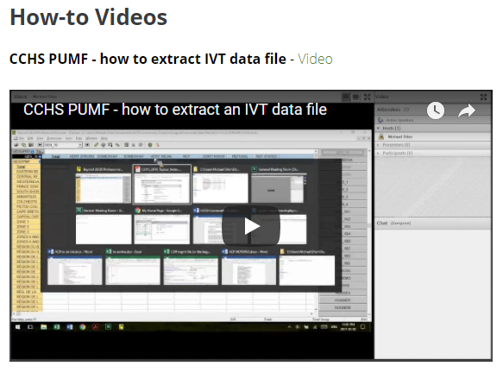
The Strategy and Action Plan
Working on a list of FAQs for the website
Preparing a series of very short videos of how-to's
Infographics are being updated with the new data
Website refresh
community data access map
resource section
further metrics

Slide 24
Upcoming Webinars
Thursday, October 5
Using Social Data in Community Evaluation: OCASI’s New Service Information System
Presented by Dr. Gillian Kerr from LogicalOutcomes
Wednesday, October 11
Community Data Fall Orientation Webinar
Presented by CDP team

Slide 25
2017/2018 Annual User Survey
Annual survey will be sent in January 2018
Questions:
Policy issues, geographies, data sets
Program resources
How often is data used
Do you participate in CDP events?
Member organization by sector, 2016/2017 Annual User Survey

Slide 26
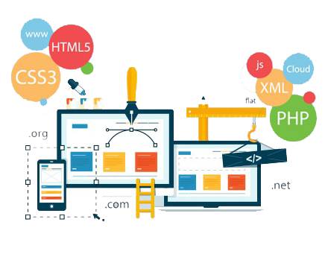
5. Website Refresh Project Update
Image credit: thomasdigital.com

Slide 27
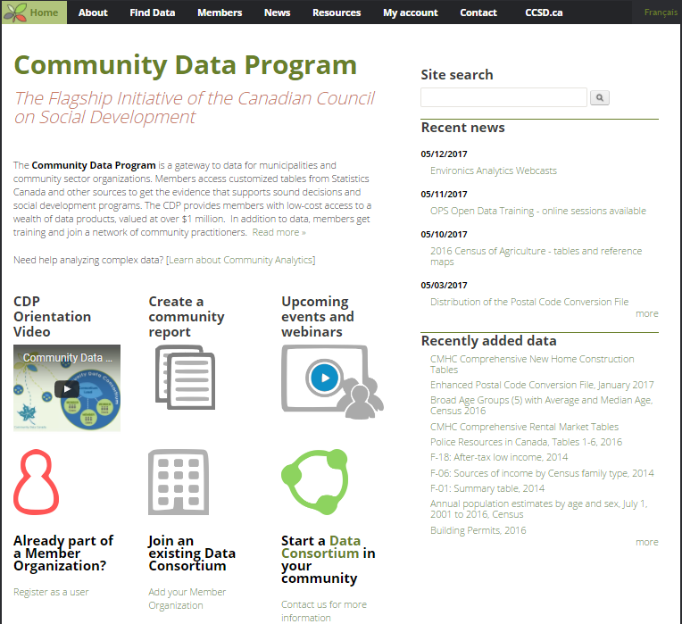
Preparing for a CDP Website Refresh & Redesign
Communitydata.ca has not been refreshed since its original launch in 2011
Two project components:
Re-theming the site, to create a fresh look and feel
Information architecture redesign, to restructure the site to optimize user access to site resources
CCSD has is reviewing proposals received from 4 vendors

Slide 28
New and expanded website features to be developed
Tab 2 Membership
NEW Dashboard of program performance indicators reflecting Strategic Plan
Tab 3 Find Data
Easier to use “Find Data by Theme”
Tab 4 Community Reporting
Expanded and better integrated DIY infographics and Data Access Map
Tab 5 Learning Centre
Expanded “How to” videos
Expanded resources from non CDP sources
Tab 6 News & Events
NEW Calendar of Program Events

Slide 29
6. Administrative Updates
a. MOA renewals
All 21 consortia with agreements that expired on March 31, 2017 have renewed until 2022
b. New Consortia since April 1, 2017
Ottawa has expanded to include most of Eastern Ontario
Regional Municipality of Wood Buffalo is a new consortium lead
Discussions are ongoing with Brant County (ON) and Edmonton
c. New 5-year renewals as of April 1, 2018: Red Deer
d. Membership fees invoices: procedures and defaults

Slide 30
7. Next AGM
Date: May 23-35, 2018
Location: Guelph, ON
Host: Wellington-Dufferin-Guelph Public Health
Image credit: @visitguelph instagram

